Slide 1

QER - 5052
QER: BID 141KM SF300065C004.8X - Zeta wire weld crack

Slide 2
Pipe section / Details
Item | Traceability / identification
Project number | SF300065C004
Project name | BID 141KM
Pipe section | SF300065C004.8X
ST number | ST101.51896
Affected layer / equipment | Spiralling
Length affected | 2985m
Drawing number / MP code / STA / Dimension | Zeta wire 6.2 (MP205)

Slide 3
Overview of anomaly
Problem Description :-
During the zeta spiraling process for BID 141KM SF300065C004.8X (ST10151896), weld crack was detected at length 2985m during weld inspection after it was laid on the pipe.
Note that, the affected weld is from joint bobbins.
Details of the defective weld are as the following: -
Weld No: 13-09
Welding machine: BS13-12
Root Cause :-
Problem Handling:-
The defective welds were rejected according to DP-QCP-08DAQT001. Therefore, the un-spiraling was then performed to remove the defective weld.
In addition, based on DI-IND-MET1075, the subsequent weld shall be retrieved if reachable for the test and analysis. The subsequent weld were gone through the tensile test, and the result is detailed below.
Tensile results for the subsequent weld:-
- Weld 14-09 (N+1): xxxmPa
The minimum criteria for the tensile test are 530mPa.
To note that, 12-09 (N-1) weld are not reachable due to being laid on a pipe at lengths 2490.9m

Slide 4
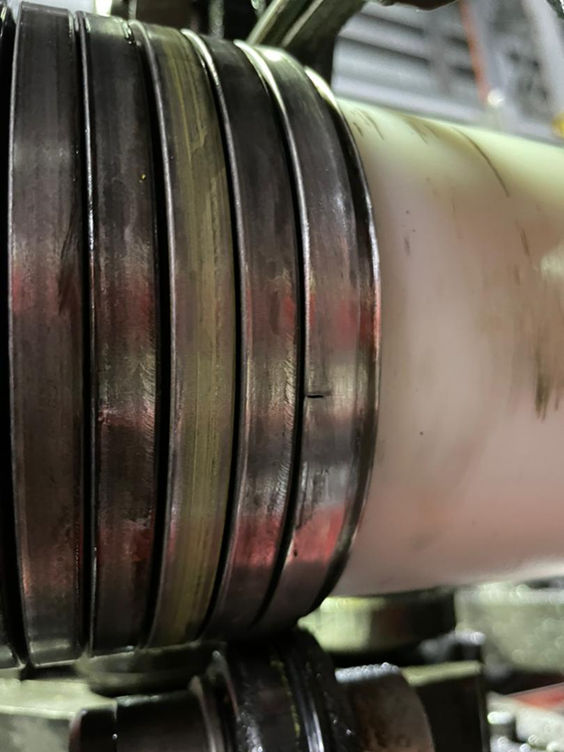
Wire crack length 2985m photo
Figure 1 : Weld crack was detected at length 2985m during weld inspection after it was laid on the pipe..

Slide 5
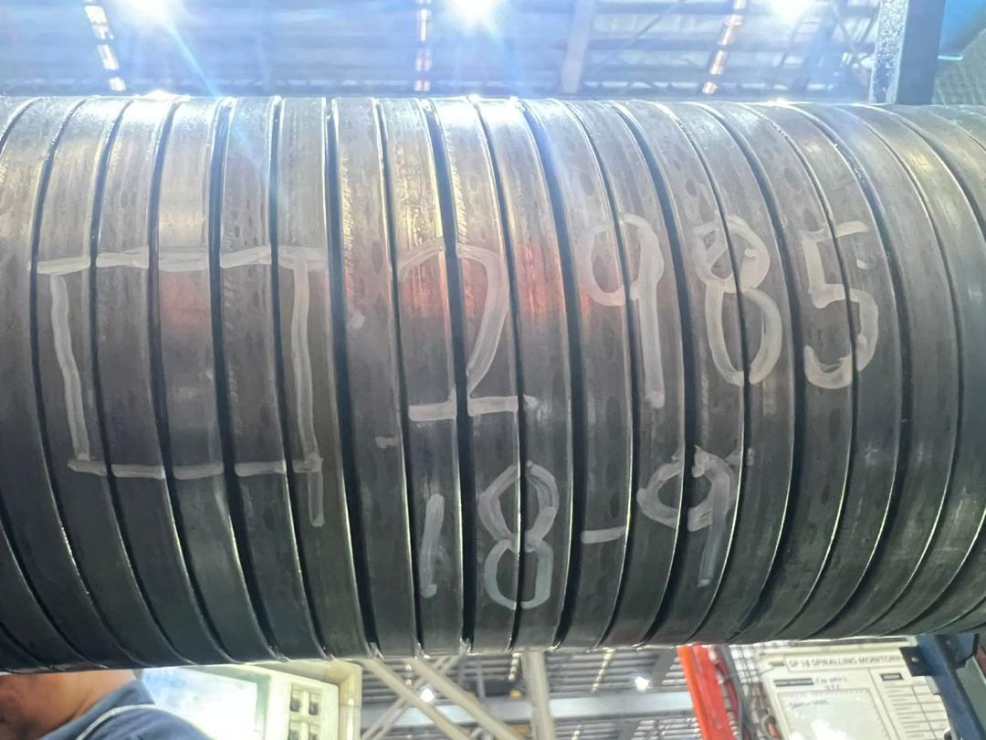
Repaired 2985m Photo
Figure 2 : Replaced with weld 18-09 from (BS13-12)

Slide 6

THANK YOU

